Slide 1
Employee Behavior and Motivation

Slide 2

Forms of Employee Behavior
Employee Behavior
  The pattern of actions by the members of an organization that directly or indirectly influences the organization's effectiveness
Notes:
Employee behavior is the pattern of actions taken by the members of an organization that directly or indirectly influences the organization’s effectiveness. For example, listening to employees in a monthly roundtable “bring your own lunch” hour in a small business can open a platform for a discussion of employee behavior.

Slide 3
Forms of Employee Behavior (cont’d)
Performance Behaviors
  The total set of work-related behaviors that the organization expects employees to display
Organizational Citizenship
  The behavior of individuals who make a positive overall contribution to the organization
Counterproductive Behaviors
  Behaviors that detract from, rather than contribute to, organizational performance
Notes:
Some other forms of employee behavior include:
Performance behaviors: These behaviors are the total set of work-related behaviors that the organization expects employees to display.
Organizational citizenship: This is the behavior of individuals who make a positive overall contribution to the organization.
Counterproductive behaviors: These are behaviors that detract from, rather than contribute to, organizational performance.

Slide 4
Counterproductive Behaviors
Absenteeism
  Results in direct costs to a business
Turnover
  Occurs when people quit their jobs
Other Behaviors
  Theft
  Sabotage
  Discriminatory harassment
  Workplace aggression and violence
Notes:
Let’s look further into counterproductive employee behaviors. Some of these, as we have identified in our groups, include:
Absenteeism, which results in direct costs to a business.
Turnover, which occurs when people quit their jobs. A manager should always do an exit interview with an employee to determine why that person is leaving the organization.
Other behaviors such as theft, sabotage, discriminatory harassment and workplace aggression and violence.

Slide 5
Individual Differences Among Employees
Individual Differences
  Personal attributes that vary from one person to another—physical, psychological, and emotional
Personality at Work
  Personality—the relatively stable set of psychological attributes that distinguish one person from another
Notes:
We need to consider individual differences among employees as a manager. Let’s look at two of these:
Individual Differences: These are personal attributes that vary from one person to another. They include:
Physical differences.
Psychological differences.
Emotional differences.
Personality at Work: Personality is the relatively stable set of psychological attributes that distinguish one person from another.

Slide 6
Individual Differences among Employees (cont’d)
The “Big Five” Personality Traits
  Agreeableness
  Conscientiousness(সুবুদ্ধি )
  Emotionality
  Extraversion(বহির্মুখীনতা )
  Openness
Notes:
OK, now let’s compare our lists to those personality traits considered to be the “Big Five”. The “Big Five” Personality Traits include:
Agreeableness.
Conscientiousness.
Emotionality.
Extraversion.
Openness.

Slide 7
Individual Differences among Employees (cont’d)
Emotional Intelligence or Emotional Quotient
  The extent to which people are self-aware, can manage their emotions, can motivate themselves, express empathy for others, and possess social skills
Attitudes
  Our beliefs and feelings about specific ideas, situations, or other people
    Are important because they are the mechanism through which we express our feelings
Notes:
Emotional Intelligence, or Emotional Quotient, refers to the extent to which people:
Are Self-aware.
Can manage their emotions.
Can motivate themselves.
Can express empathy for others.
Possess social skills.
In addition, our attitudes, which are our beliefs and feelings about specific ideas, situations, or other people, are important because they are the mechanism through which we express our feelings.

Slide 8
Attitudes at Work
Job Satisfaction (Morale)
  The extent to which people have positive attitudes toward their jobs
Organizational Commitment
  An individual’s identification with the organization and
  its mission
Promoting Satisfaction and Commitment
  Treat employees fairly
  Provide rewards and job security
  Allow employee participation
  Design interesting jobs
  Maintain psychological contracts
Notes:
Now let’s explore some of our attitudes at work. You will remember from the last slide that attitudes are our beliefs and feelings about specific ideas, situations or other people. Some examples of attitudes at work include:
Job Satisfaction or Morale: This is the extent to which people have positive attitudes toward their jobs.
Organizational Commitment: This is an individual’s identification with the organization and its mission.
Promoting Satisfaction and Commitment: This includes:
Treating employees fairly.
Providing rewards and job security.
Allowing employee participation.
Designing interesting jobs.
Maintaining psychological contracts.

Slide 9
Matching People and Jobs
Psychological Contract
  The overall set of expectations held by employees and the organization regarding what employees will contribute to the organization and what the organization will provide in return
Contributions
  What does each employee expect to contribute to the organization?
Inducements
  What will the organization provide to each employee in return?
Notes:
Matching people with the correct jobs is very important for a healthy and productive work environment.
One of the elements we touched on a few moments ago is the Psychological Contract, which is the overall set of expectations held by employees and the organization regarding what employees will contribute to the organization and what the organization will provide in return.
In arriving at this psychological contract we also should examine contributions: What does each employee expect to contribute to the organization?
In addition we need to examine inducements. What will the organization provide to each employee in return?

Slide 10
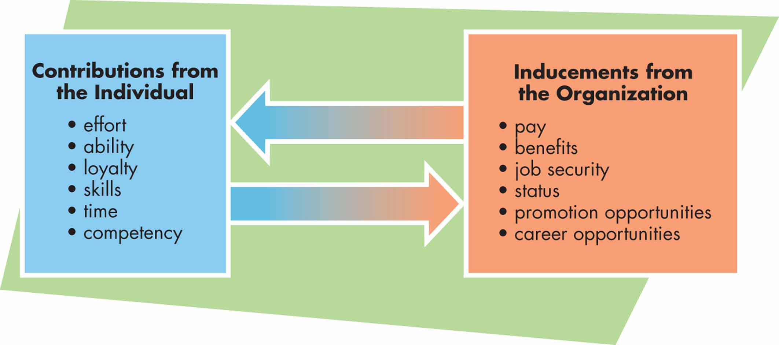
FIGURE 8.1 The Psychological Contract
Notes:
Let’s take a look at the psychological contract from a visual perspective.
Contributions from the individual can include:
Effort.
Ability.
Loyalty.
Skills.
Time.
Competency.
Inducements from the organization can include:
Pay.
Benefits.
Job security.
Status.
Promotion opportunities.
Career opportunities.

Slide 11

Matching People and Jobs (cont’d)
Person-Job Fit
  The extent to which a person’s contributions and the organization’s inducements match one another
    Good person-job fit can result in higher performance and more positive attitudes
    A poor person-job fit can have the opposite effects
Notes:
As we move to match people to jobs within an organization, we need to examine the Person-Job fit. This is the extent to which a person’s contributions and the organization’s inducements match one another.
A good person-job fit can result in higher performance and more positive attitudes.
A poor person-job fit can have the opposite effects.

Slide 12
Basic Motivation Concepts and Theories
Motivation
  The set of forces that cause people to behave in certain ways
Approaches to Human Relations
  Classical theory and scientific management
  Early behavioral theory
  Contemporary motivational theories
Notes:
Let’s examine basic employee motivation concepts and theories. First, let’s define motivation. Motivation is the set of forces that cause people to behave in certain ways.
The area of a company that deals with these issues is called Human Relations, or Human Resources. Let’s examine three different approaches to human relations:
Classical theory and scientific management.
Early behavioral theory.
Contemporary motivational theories.

Slide 13
Classical Theory
Scientific Management (Frederick Taylor)
  Paying workers more motivates them to
  produce more
  Industrial engineering: Analyzing jobs to find better ways to perform them makes goods cheaper, creates higher profits, and allows the firm to better pay and motivate its workers
Notes:
Let’s look first at the Classical Theory, called Scientific Management, a theory developed by Frederick Taylor. This theory states that paying workers more motivates them to produce more.
This theory also focuses on industrial engineering, or the idea that analyzing jobs to find better ways to perform them makes goods cheaper, creates higher profits and allows the firm to better pay and motivate its workers.

Slide 14
Early Behavioral Theory
Hawthorne Studies
  Original purpose was to examine the relationship between changes in the physical environment and worker output (productivity).
  Hawthorne effect: Worker productivity rose in response to any management actions that workers interpreted as special attention.
Other Major Motivation Theories
  Human Resources Model (Theories X and Y)
  Maslow’s Hierarchy of Needs Model
  Herzberg’s Two-Factor Theory
Notes:
Next let’s examine early behavioral human relations theory. First we will examine the Hawthorne Studies.
The original purpose of the studies was to examine the relationship between changes in the physical environment and work output or productivity.
The Hawthorne effect, which was observed in the studies, states: Worker productivity rose in response to any management actions that workers interpreted as special attention.
We will also examine other major motivation theories in the next few minutes. These include:
Theory X and Theory Y, also called the human resources model
Maslow’s Hierarchy of Needs Model
Herzberg’s Two-Factor Theory

Slide 15
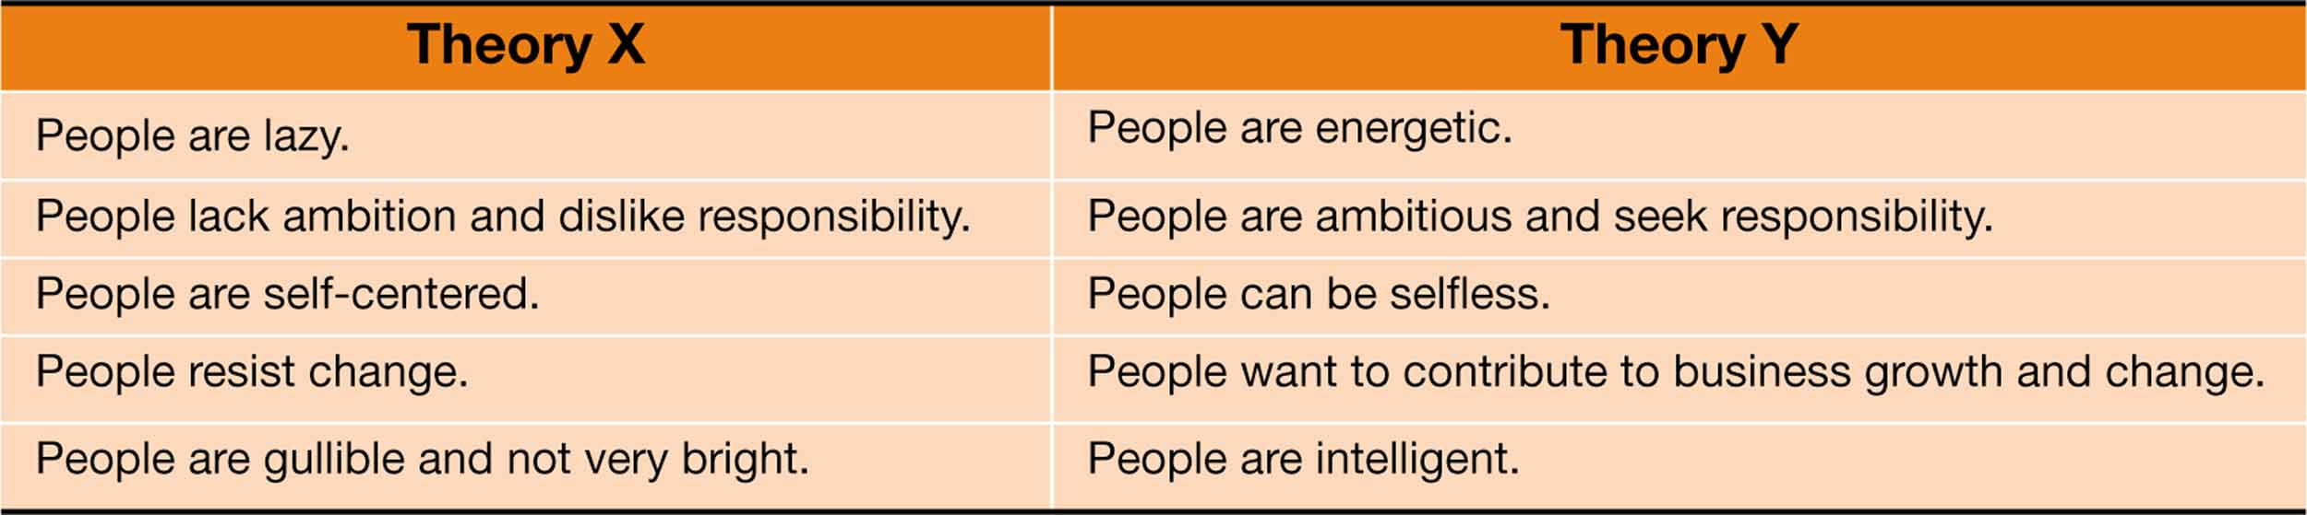
TABLE 8.1 Theory X and Theory Y
Notes:
Let’s examine the human resources model of Theory X and Theory Y. Developed by Douglas MacGregor, this model states that managers have two very different views of employees and hence ways of managing them. Let’s look at each theory and the managerial beliefs of each:
Theory X states that:
People are lazy.
People lack ambition and dislike responsibility.
People are self-centered.
People resist change.
People are gullible and not very bright.
Theory Y states that:
People are energetic.
People are ambitious and seek responsibility.
People can be selfless.
People want to contribute to business growth and change.
People are intelligent.

Slide 16
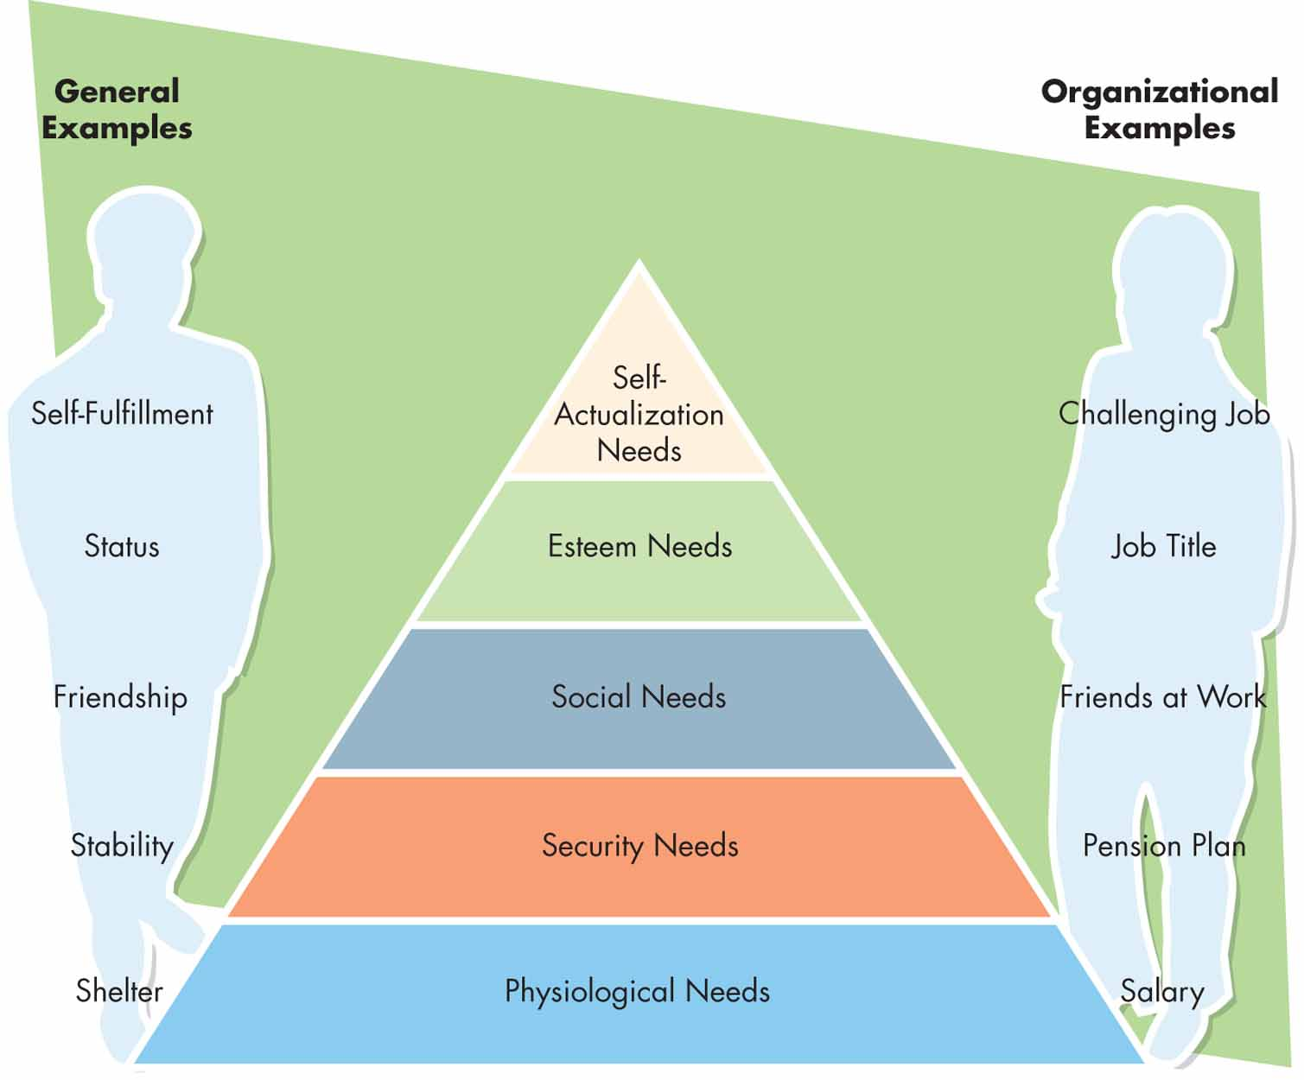
FIGURE 8.2 Maslow’s Hierarchy of Needs
Notes:
Another theory of human relations is Maslow’s Hierarchy of Needs. Authored by Abraham Maslow, this theory states that people cannot move up the pyramid of motivation until they have met the needs of the level below. Let’s look at these levels:
The basic needs are psychological needs, like making sure they have food, clothing, and water, which are all very basic.
Security needs can only be addressed once one has something to protect, like a house and a family.
The social needs mean forming relationships with others.
Esteem needs deal with the status a person chooses to have or aspire toward.
Finally, self-actualization needs refer to making a difference within a company, a community or society and finding peace with one’s life.
This chart provides us with examples of each level from both a personal and organizational perspective.
Psychological needs can include shelter from a personal standpoint or a salary from an organizational standpoint.
Security needs can include stability on a personal level and the inclusion of pension plans from an organizational viewpoint.
Social needs can include friendship on a personal level or friends at work from an organizational viewpoint.
Esteem needs could include status on a personal level, like driving the best car, or a higher job title from an organizational viewpoint.
Self-actualization needs include self-fulfillment on a personal level or a challenging job on the organizational level.

Slide 17
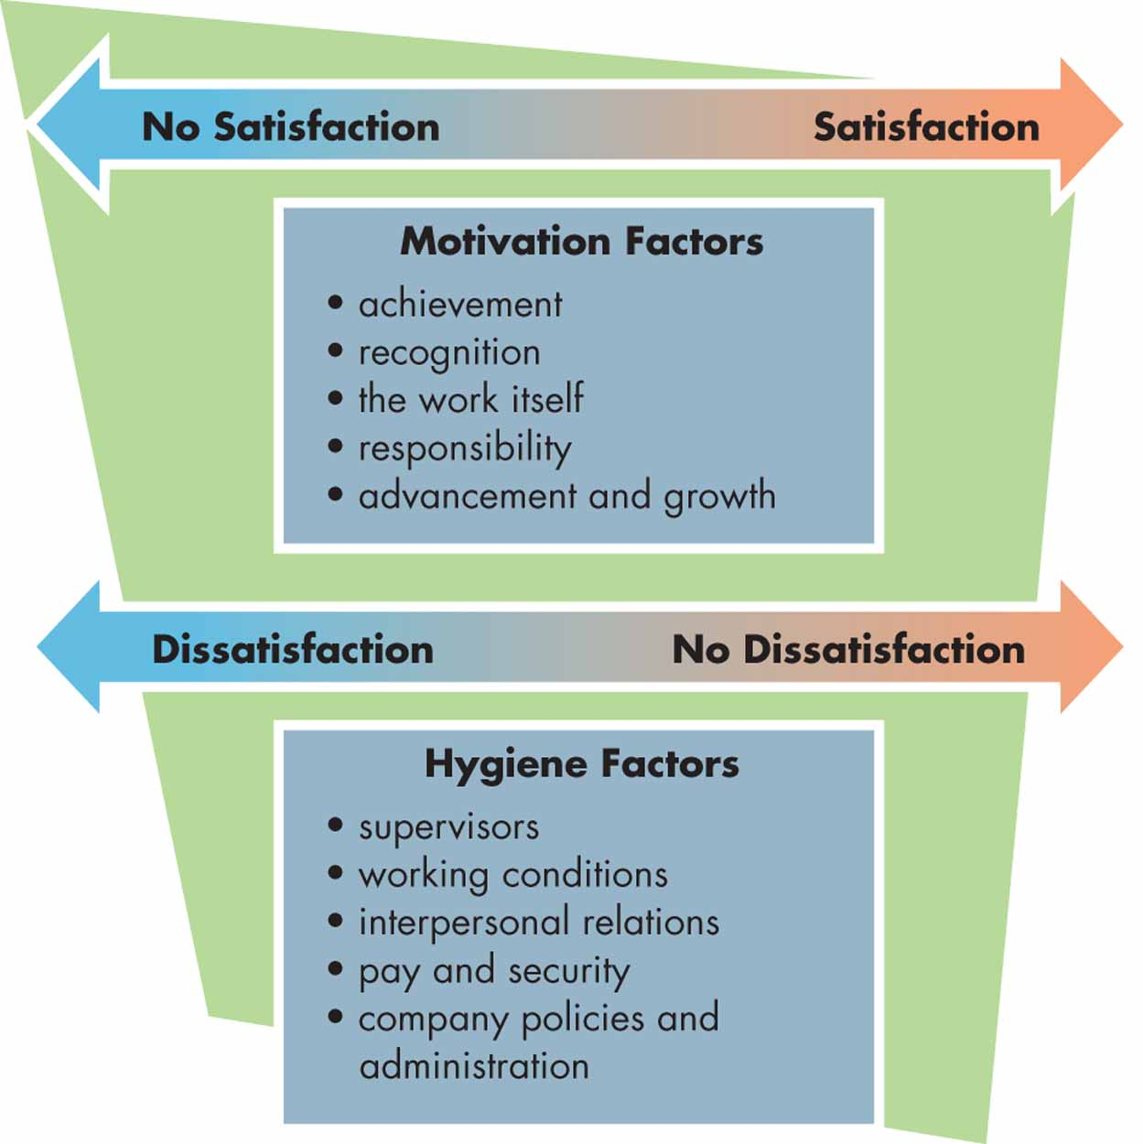
FIGURE 8.3 Two-Factor Theory
Notes:
Now we will examine the Two-Factor Theory. The Two-Factor Theory was developed by Frederick Herzberg after he studied a group of accountants and engineers. He concluded that job satisfaction or dissatisfaction relies on two factors:
The first is Motivation Factors, which include:
Achievement.
Recognition.
The work itself.
Responsibility.
Advancement and growth.
The second are hygiene factors. These include:
Supervisors.
Working conditions.
Interpersonal relations.
Pay and security.
Company policies and administration.
Herzberg found that addressing hygiene factors will move employees attitudes from dissatisfaction to no dissatisfaction, but will not impact satisfaction.
On the other hand, addressing motivation factors moves employees from a state of no satisfaction toward satisfaction.

Slide 18
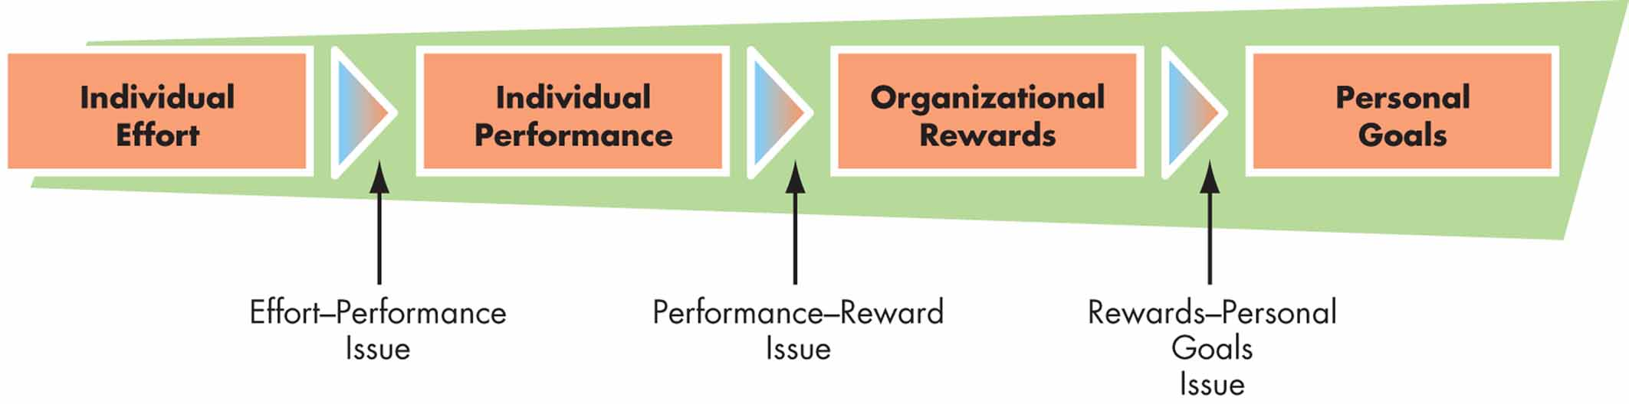
Contemporary Motivation Theory
Expectancy Theory
  Suggests that people are motivated to work toward rewards that they want and that they believe they have a reasonable chance—or expectancy—of obtaining
  Helps explain why some people do not work as hard as they can when their salaries are based purely on seniority
Notes:
Now we will look at more contemporary motivation theories. One of these theories is called Expectancy Theory. Expectancy theory suggests that people are motivated to work toward rewards that they want and that they believe they have a reasonable chance—or expectancy—of obtaining. This theory helps explain why some people do not work as hard as they can when their salaries are based purely on seniority.
The model we are looking at shows individual effort leading to individual performance, with effort as the performance issue. Next the model moves from individual performance to organizational rewards, with performance being the key reward issue. Finally the model moves from organizational rewards to personal goals, with rewards as the personal goal issue.

Slide 19
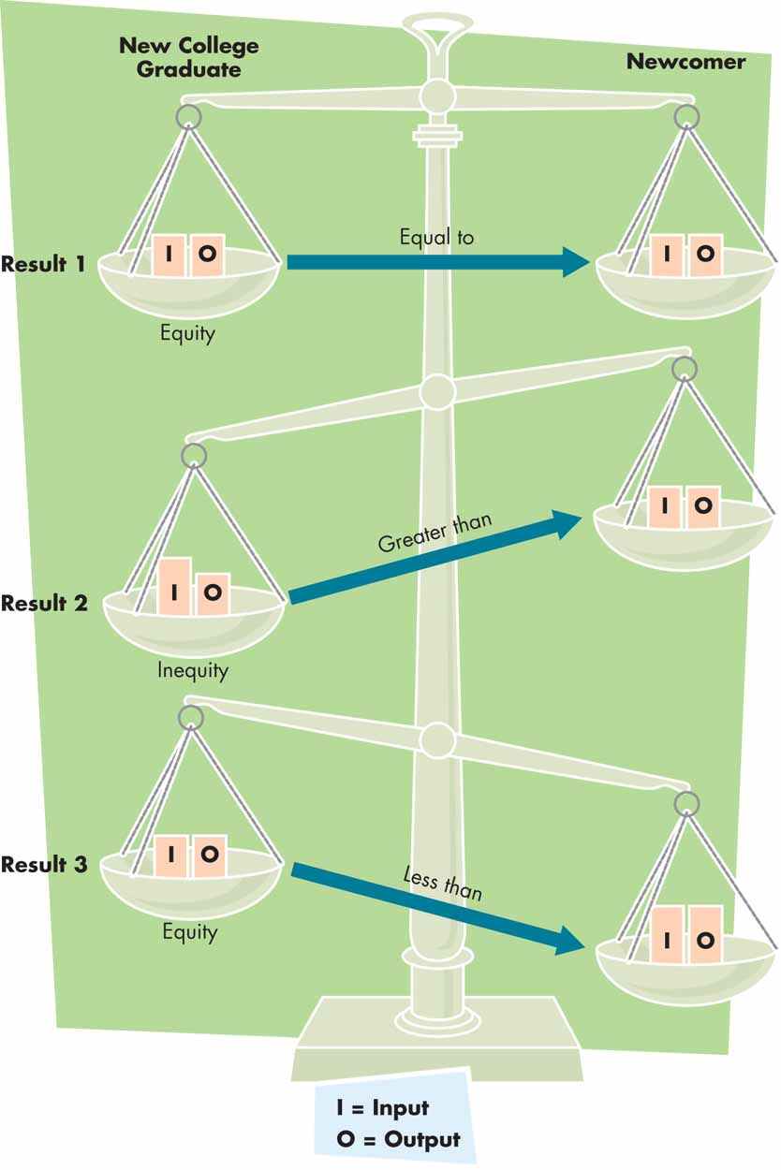
Contemporary Motivation Theory (cont’d)
Equity Theory
  Employees evaluate their treatment relative to the treatment of others
    Inputs: Employee contributions to their jobs
    Outputs: What employees receive in return
  The perceived ratio of contribution to return determines perceived equity
Notes:
Another contemporary motivation theory is Equity Theory. Within this model, employees evaluate their treatment relative to the treatment of other. They examine:
Inputs or employee contributions to their jobs.
Outputs or what employees receive in return.
The perceived ration of contribution to return determines perceived equity.

Slide 20
Strategies and Techniques for Enhancing Motivation
Reinforcement/Behavior Modification
Management by Objectives
Participative Management
and Empowerment
Team Management
Job Enrichment and Job Redesign
Modified Work Schedules
Notes:
We will now examine a number of strategies and techniques for enhancing motivation in the workplace. These include:
Reinforcement/Behavior Modification.
Management by Objectives.
Participative Management and Empowerment.
Team Management.
Job Enrichment and Job Redesign.
Modified Work Schedule and Locations.

Slide 21
Reinforcement/Behavior Modification Theory
Punishment
When negative consequences are attached directly to undesirable behavior
Positive Reinforcement
When rewards are tied directly to performance
Notes:
Let’s begin by examining the reinforcement/behavior modification theory. This theory holds that punishment and positive reinforcement are the key to motivation.
Punishment is used when negative consequences are attached directly to undesirable behavior.
Positive reinforcement is used when rewards are tied directly to performance.

Slide 22
Management by Objectives (MBO): Collaborative Goal-setting
Collaborative Goal Setting and Planning
Communicating Organizational Goals and Plans
Periodic Review
Evaluation
Meeting
Setting
Verifiable Goals
and Clear Plans
Counseling
Identifying Resources
Notes:
Now let’s examine management by objectives. Management by objectives, or MBO, calls for collaborative goal-setting. Let’s examine the process in this chart:
First, collaborative goal-setting and planning is done by management with input from employees.
Second, the organizational goals and plans are communicated to employees through a meeting.
In the meeting, management should work with employees to set verifiable goals and clear plans for implementation.
In addition, counseling should be provided to employees so they can stay on track with goals.
Resources are identified at this point to assist in meeting the goals and plans.
Third, a periodic review is done with employees against the goals that have been set.
Finally, the employee is evaluated against the goals and alterations, which allows the employee to provide information for the next set of collaborative goal-setting and planning.

Slide 23

Participative Management, Empowerment and Team Management
Increasing job satisfaction by encouraging participation
Team management represents an increasing trend
  For example, in smaller, more flexible organizations make decisions more quickly and efficiently
Notes:
Now we will examine participative management, empowerment and team management.
Participative management and empowerment both increase job satisfaction by encouraging participation of employees.
Team management is increasing as a trend in managing projects and people.
For example, in smaller, more flexible organizations make decisions more quickly and efficiently.

Slide 24
Job Enrichment and Job Redesign
Job Enrichment
  Adding one or more motivating factors to job activities (such as increasing responsibility or recognition)
Job Redesign
  Designing a better fit between workers and their jobs
    Combining tasks
    Forming natural work groups
    Establishing client relationships
Notes:
Job enrichment and job redesign are two important methods of motivation. Let’s examine both.
Job enrichment includes adding one or more motivating factors to job activities, such as increasing responsibility or recognition for an employee.
Job redesign includes designing a better fit between workers and their jobs. This can include:
Combining tasks.
Forming natural work groups.
Establishing client relationships.

Slide 25
Modified Work Schedules
Work-Share Programs (Job Sharing)
  Pros: Employees appreciate attention to their needs, company can reduce turnover and save on benefits
  Cons: Job-share employees generally receive fewer benefits and may be the first to be laid off
Flex-time Programs/Alternative Workplace Strategies
  Allow people to choose their work hours by adjusting a standard work schedule
Telecommuting
  Performing a job away from standard office settings
Notes:
Modified work schedules are another way to motivate employees. Let’s look at three examples.
Work-share or job-sharing programs.
Pros: Employees appreciate attention to their needs and schedules, such as having young children at home and wanting to remain in the workforce but at a reduced level.
Pros: The company can reduce turnover and save on benefits.
Cons: Job-share employees generally receive fewer benefits and may be the first to be laid off.
Flex-time programs and alternative workplace strategies.
These program allow people to choose their work hours by adjusting a standard work schedule or to work at alternate locations.
Telecommuting allows employees to perform their job away from standard office settings.

Slide 26
Modified Work Schedules and Alternative Workplaces
Advantages
  More satisfied, committed employees
  Reduced stress
  Improved productivity
  Less congestion
Disadvantages
  Challenging to coordinate and manage
  Poor fit for some workers
  Lack of network and coworker contact
  Lack of management belief
Notes:
Let’s look at some advantages and disadvantages to modified work schedules and alternative workplaces.
Advantages include:
More satisfied, committed employees.
Reduced stress.
Improved productivity.
Less congestion.
Disadvantages include:
These types of modifications are challenging to coordinate and manage.
They could be a poor fit for some workers.
There is a lack of network and coworker contact.
There is a lack of management belief.

Slide 27
Attitudes
Attitudes
Evaluative statements or judgments concerning idea, objects, people, or events
Cognitive Component
The opinion or belief segment of an attitude
Affective Component
The emotional or feeling segment of an attitude
Behavioral Component
An intention to behave in a certain way toward someone or something

Slide 28
The Theory of Cognitive Dissonance
Cognitive Dissonance
Any incompatibility between two or more attitudes or between behavior and attitudes
Individuals seek to reduce this gap, or “dissonance”
Desire to reduce dissonance depends on:
Importance of elements creating dissonance
Degree of individual influence over elements
Rewards involved in dissonance

Slide 29
Types of Attitudes
Job Satisfaction
A collection of positive and/or negative feelings that an individual holds toward his or her job
Job Involvement
Identifying with the job, actively participating in it, and considering performance important to self-worth
Organizational Commitment
Identifying with a particular organization and its goals, and wishing to maintain membership in the organization (Affective, Normative, and Continuance Commitment)

Slide 30
Types of Attitudes, cont’d
Perceived Organizational Support (POS)
Degree to which employees feel the organization cares about their well-being
Employee Engagement
An individual’s involvement with, satisfaction with, and enthusiasm for the organization

Slide 31

Job Satisfaction
How Satisfied Are People in Their Jobs?
  In general, people are satisfied with their jobs.
  Depends on facets of satisfaction—tend to be less satisfied with pay and promotion opportunities

Slide 32
Causes of Job Satisfaction
Pay influences job satisfaction only to a point.
  After about $40,000 a year, there is no relationship between amount of pay and job satisfaction.
Personality can influence job satisfaction.
  Negative people are usually not satisfied with their jobs.

Slide 33
How Employees Can Express Dissatisfaction
Exit
Behavior directed toward leaving the organization
Voice
Active and constructive attempts to improve conditions
Loyalty
Passively waiting for conditions to improve
Neglect
Allowing conditions to worsen

Slide 34
The Effect of Job Satisfaction on Employee Performance
Satisfaction and Productivity
  Satisfied workers are more productive AND more productive workers are more satisfied!
  Worker productivity is higher in organizations with more satisfied workers.
Satisfaction and Absenteeism
  Satisfied employees have fewer avoidable absences.
Satisfaction and Turnover
  Satisfied employees are less likely to quit.
  Organizations take actions to retain high performers and to weed out lower performers.

Slide 35

Job Satisfaction and OCB
Satisfaction and OCBs
  Satisfied employees who feel fairly treated by and are trusting of the organization are more willing to engage in behaviors that go beyond the normal expectations of their job.

Slide 36

Job Satisfaction and Customer Satisfaction
Satisfaction and Customer Satisfaction
  Satisfied workers provide better customer service.
Satisfied employees increase customer satisfaction because:
  They are more friendly, upbeat, and responsive.
  They are less likely to turnover, which helps build long-term customer relationships.
  They are experienced.
Dissatisfied customers increase employee job dissatisfaction.

Slide 37
Organizational Commitment
An employee’s loyalty to the organization, willingness to exert effort on behalf of the organization, associated with the acceptance of the organization’s goal and values and desire to maintain membership.
A worker’s feeling and attitudes about the entire work organizations.

Slide 38
(A) Affective Commitments
Emotional attachment, identification, and involvement that an employee has with its organization and goals.
(B) Continuance Commitment
Willingness to remain in an organization because of the investment that the employee has with “ nontranferable” investment.
** Employees who share continuance commitment with their employer
often make it very difficult for an employee to leave the organization.
(C) Normative commitments
Commitment of people believes that they have to stay in the organization or their feeling of obligation to their workplace.

Slide 39
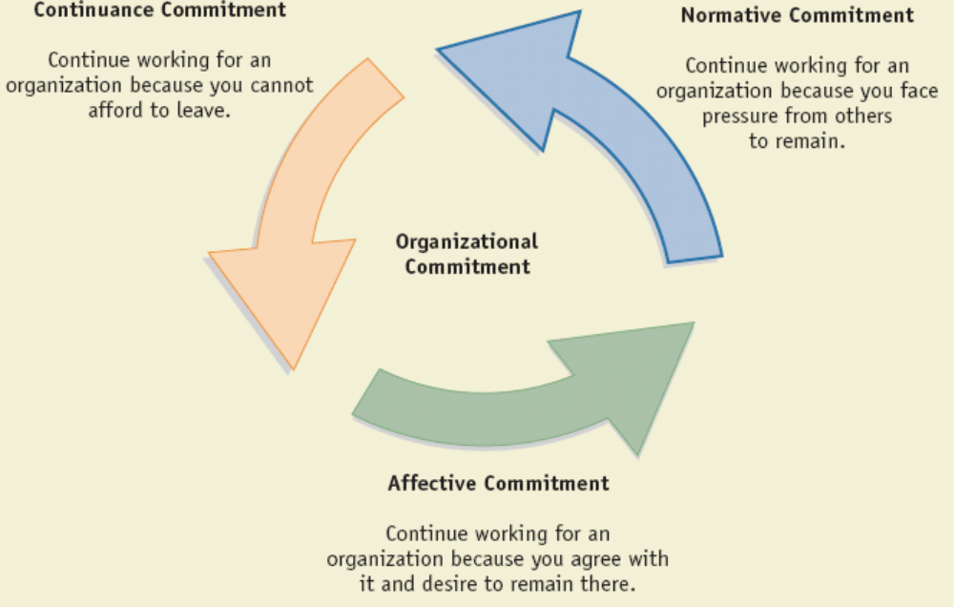
Organizational Commitment
6-<number>

Slide 40
Committed Workforce Consequences
Unlikely to withdraw
Willing to make sacrifices for their organizations
6-<number>

Slide 41
Organizational Commitment Development
Enrich jobs
Align company and employees interests
Recruit and select new employees whose values closely match organization values
6-<number>

